Slide 1
13TH
EUROPEAN
BOARD
EXAMINATION
IN
NEUROLOGY
Vienna • June 18 2021
Presented at the
Virtual EAN Congress
May 24th 2020

Slide 2
www.uems-neuroboard.org
j.b.m.kuks@umcg.nl
Information
Advices
Presented at the
Virtual EAN Congress
May 24th 2020

Slide 3
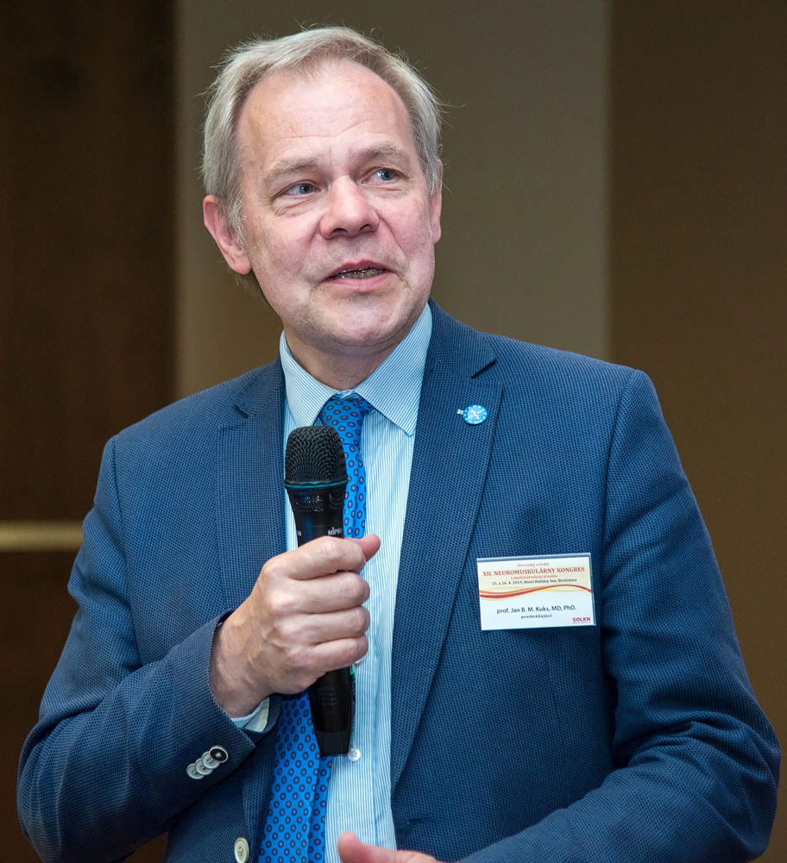
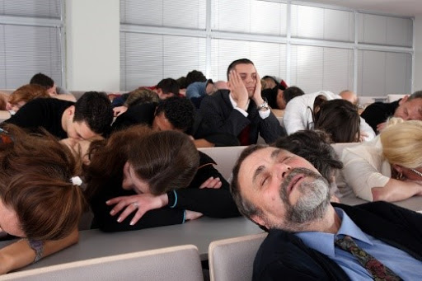
Prof Jan Kuks (NL)
Chair Examination Committee

Slide 4
The European Board of Neurology
aims at Harmonisation of
Postgraduate Training of Specialists.

Slide 5
Board Exam Clinical Neurology
UEMS
A European board certification is
a process by which a medical
specialist demonstrates a mastery
of competencies required for
practicing in an area of
medical specialization.

Slide 6
Why should we take
this examination?

Slide 7
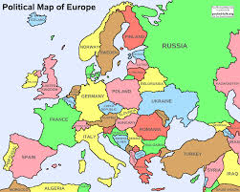
To help you migrating within Europe
To show your level of excellence
and to become a
Fellow of the
European Board of Neurology

Slide 8
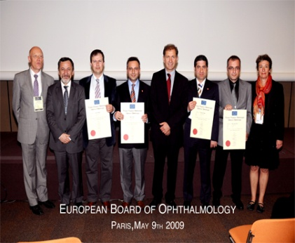
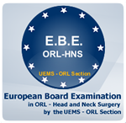
There are many
European Examinations
Allergology and clinical Immunology
Anesthaesiology
Cardiology
Cardiovascular Surgery
Dermatology and Venerology
Endocrine Surgery
Gastrointestinal Medicine
General Surgery
Hand Surgery
Internal Medicine
Intensive Care
Neurology
Neurosurgery
Nuclear Medicine
Ophthalmology
Oral Surgery
Orthopedics and Traumatology
Otolaryngology
Pathology
Pediatric Surgery
Pulmonology
Rehabilitation Medicine
Reconstructive Surgery
Surgical Oncology
Transplantation Medicine
Urology
Vascular diseases
Vascular Surgery

Slide 9
Candidates
2016 2017 2018 2019
Subscriptions 96 76 89 109
Cancellations 24 14 15 12
Remaining 72 62 74 97

Slide 10
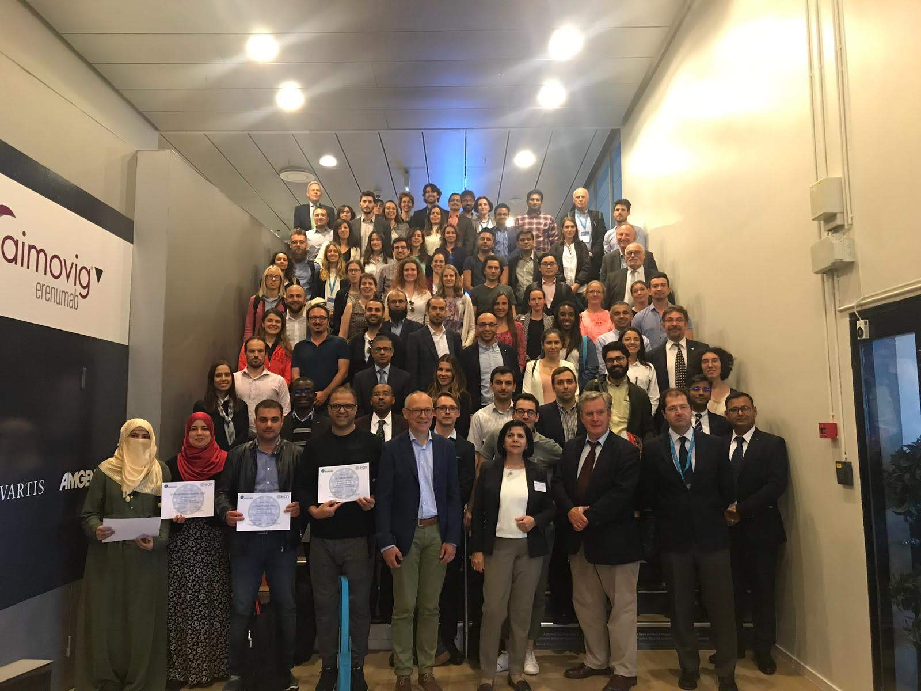
Successful candidates Oslo 2019

Slide 11
Candidates and their workplaces Oslo 2019
Austria 1
Belgium 16
Denmark 4
France 1 (+6)
Germany 6
Greece 1
Ireland 1
Italy 23
Lithuania 1
Portugal 3
Romania 2
Russia 1
Slovenia 1
Spain 1
Sweden 1
Turkey 7
United Kingdom 5
European 75
Bahrein 1
Egypt 4
India 9
Iraq 3
Jordan 1
Kuwait 1
Libanon 1
Malaysia 1
Oman 1
Qatar 1
Saudi Arabia 9
United States 2
Non European 34

Slide 12
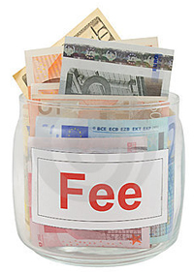
Admission Fees (Euros) Early Bird Normal
EAN-associated countries 600 650
Other non-European countries 750 800
Low & lower-middel income countries* 350 400
*Details on our website
Early bird fees for the exam until March 2021
Reduction for those working in low income countries
Free access for candidates having paid for the cancelled 2020-Exam
Discount for the EAN congress for all (20% members, 10% non-members EAN/RRFS)

Slide 13
What will be tested?

Slide 14
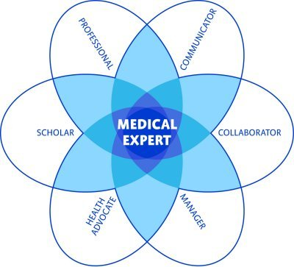
We do not want you just
to retrieve dry knowledge but to show your other
competencies as well.
Therefore we also test
presentation abilities
handling knowledge
discussing ethics and public health topics
clinical reasoning
scientific reasoning
CANMEDs roles

Slide 15
You do not want us to take a
snapshot on the day of the
examination.
You definitely want us to test
your competencies as they
are there in your daily life.
Therefore we allow you to do part
of the exam at your own desk
and to use your own reference sources
during the Exam!

Slide 16
How will this
be examined?
Step 1
Written
Step 2
Oral

Slide 17
Written Part (70%)
100 Multiple Choice questions clinical neurology
60% cases with open Book

Slide 18
MCQ open Book ?

Slide 19
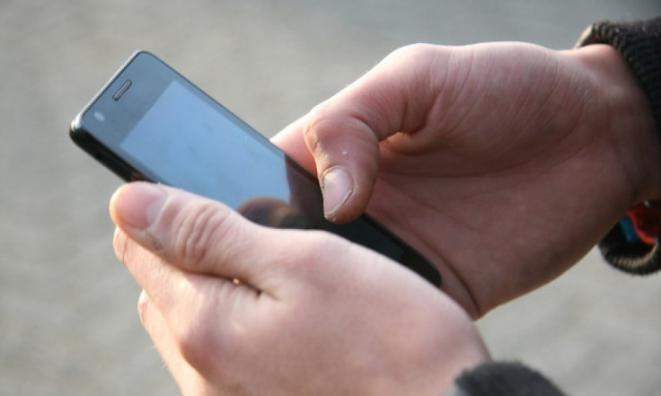
MCQ open Book !
Open Book Exams
to test on a higher level,
to approach ‚real world‘
Unfortunately we
are not yet ready for
allowing electronic
devices

Slide 20
How can we
prepare ourselves for this part?

Slide 21
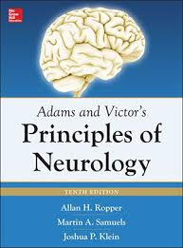
About 90% of the written
questions is derived from
these sources
European
Guidelines
(EFNS/EAN)
Textbook

Slide 22
Oral Part (30%)
Critical appraisal of a topic
Essay on public health or ethics
Clinical case presentation

Slide 23
How can we
prepare ourselves for this part?
www.uems-neuroboard.org
for comprehensive instructions and examples

Slide 24
The oral exam deals with other competencies
than knowledge and can be fully prepared at home.
Submissions should be sent in before the
oral examination and will be judged by a team.
Suggestions for improvement may be given.
At the exam, submissions will be discussed,
a home-made powerpoint may support the debate.

Slide 25
What are my chances
of passing this exam?
Step 1
Written
Step 2
Oral

Slide 26
Total Results
90 – 100 2% 1% 4%
80 – 90 21% 19% 18% 14% 5% 10%
70 – 80 22% 32% 37% 42% 33% 21%
60 – 70 31% 22% 21% 20% 17% 39%
55 – 60 12% 12% 18% 13% 32% 23%
------------------------------------------------------------------------------
40 – 55 12% 14% 4% 7% 13% 7%
2019 2018 2017 2016 2015 2014
P
A
S
S
F
A
I
L

Slide 27
We aim at conferring the certificate
immediately after the exam
Unfortunate candidates will be informed in a discrete way before the final ceremony and get a new chance at a next exam
against a greatly reduced fee

Slide 28
Feedback from the
Candidates
Too difficult
It was perfect exam
I thoroughly enjoyed having this exam. It is very well structured and organized.
I like this exam. I think it improves neurologic process
As with any form of exam, only strict and contingent quality measures will result in a good reputation! Do not lower the difficulties!
Thank you for the great opportunity, it was a pleasure

Slide 29
Feedback to the
Candidates
After the exam an individual report
will be sent by e-mail

Slide 32
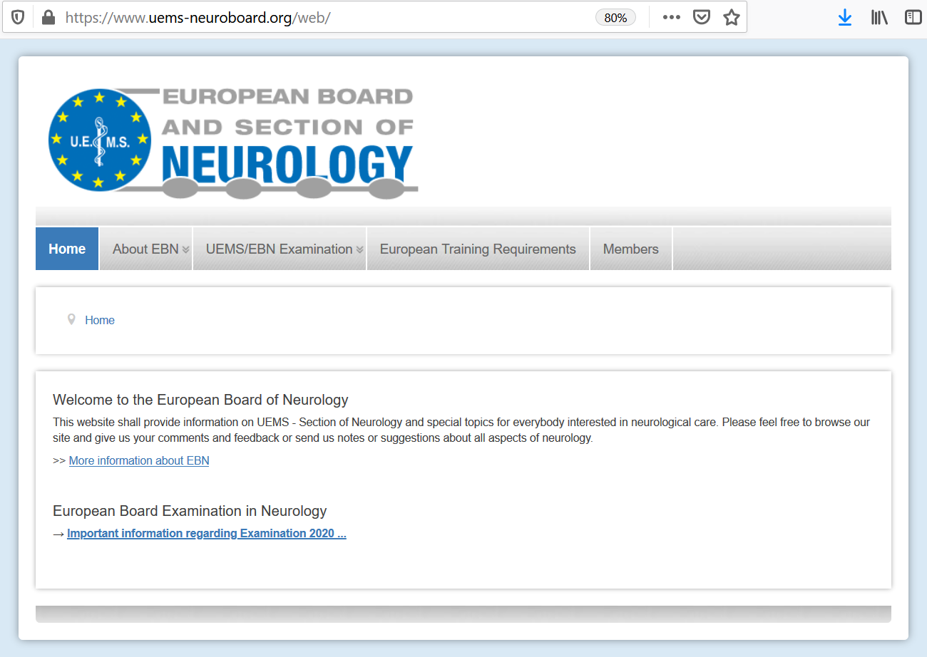
www.uems-neuroboard.org

Slide 34
www.uems-neuroboard.org
j.b.m.kuks@umcg.nl
Information
Advices
Presented at the
Virtual EAN Congress
May 24th 2020

